Slide 1
Summary of 2025 UFT and IM Results and 2022–2025 Multi‑Year Fungicide Performance
FHB Severity, DON Accumulation, and Percent Control Across Host Classes and Fungicide Programs

Slide 2
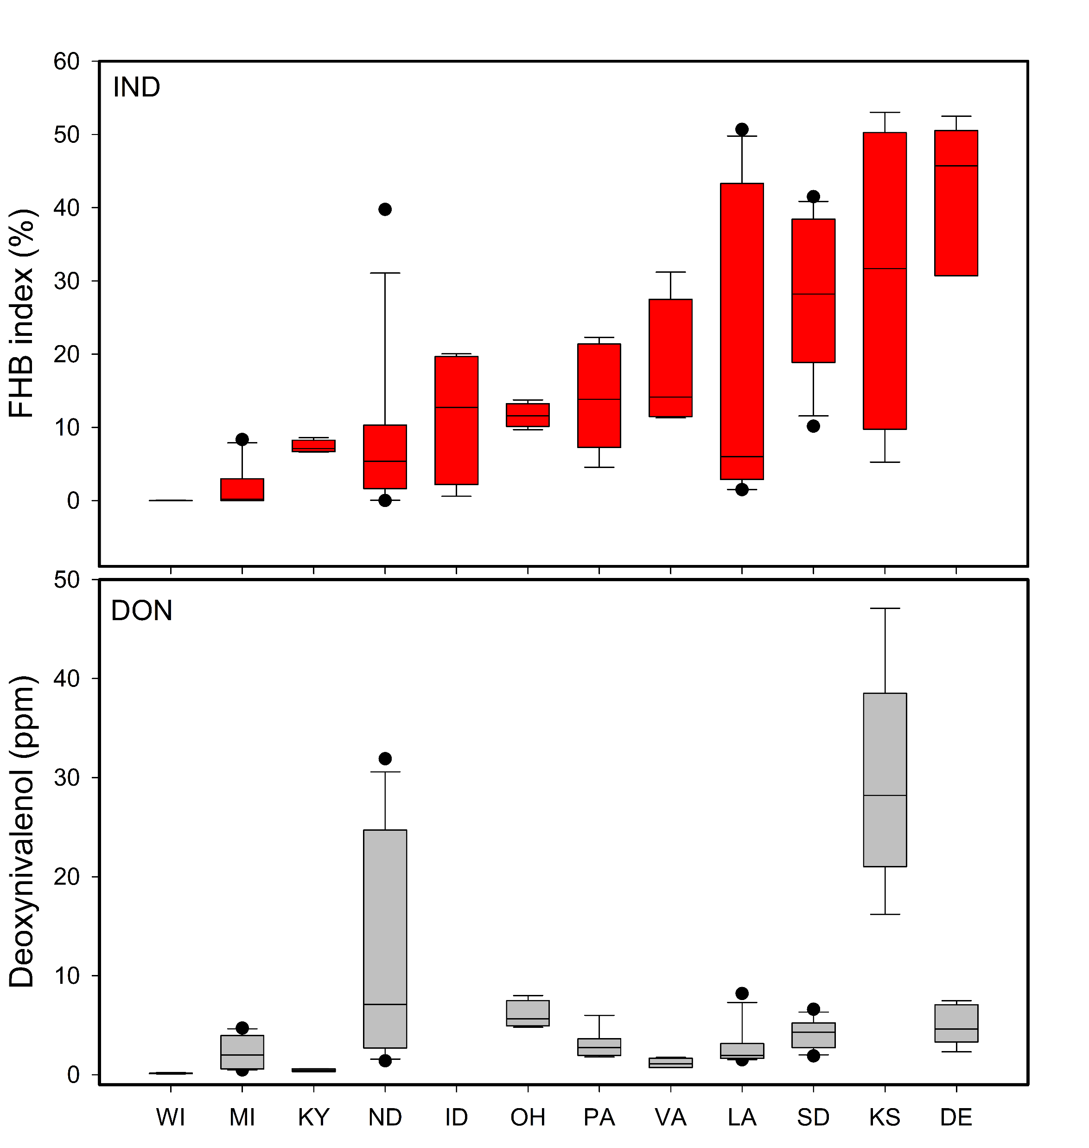
2025 FHB Severity and DON Accumulation Across 12 States
(Non‑treated Plots from Uniform Fungicide Trials)
Distribution of Fusarium Head Blight (FHB) IND and deoxynivalenol (DON) levels from non‑treated UFT wheat plots collected in 12 U.S. states during 2025 growing season.
Boxplots show the variability in disease severity (top panel) and DON accumulation (bottom panel) across locations in non-treated checks.

Slide 3
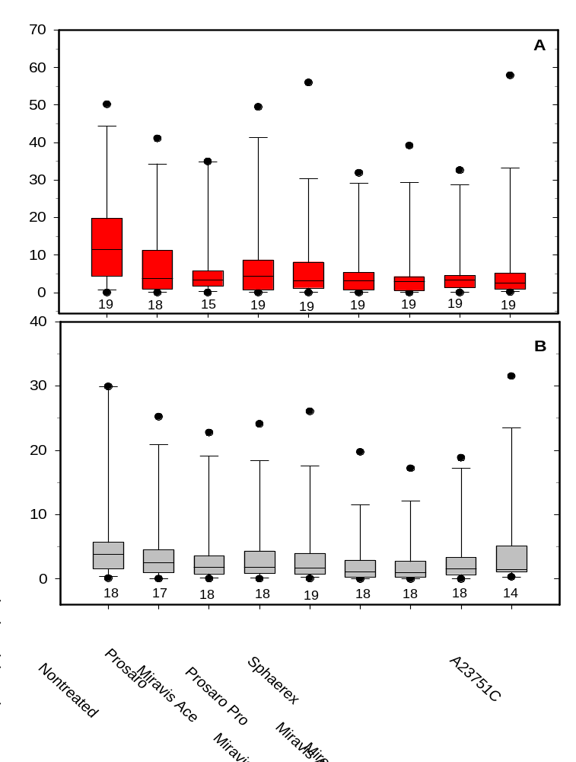
2025 FHB Index and DON Response to Fungicide Treatments from UFT Trials
Distribution of least squares means for Fusarium head blight (FHB) index (A) and deoxynivalenol (DON) levels (B) from multi‑location field trials conducted during the 2025 growing season.
Boxplots summarize variability across fungicide treatments.
The number of trials contributing to each treatment is displayed below each box

Slide 4
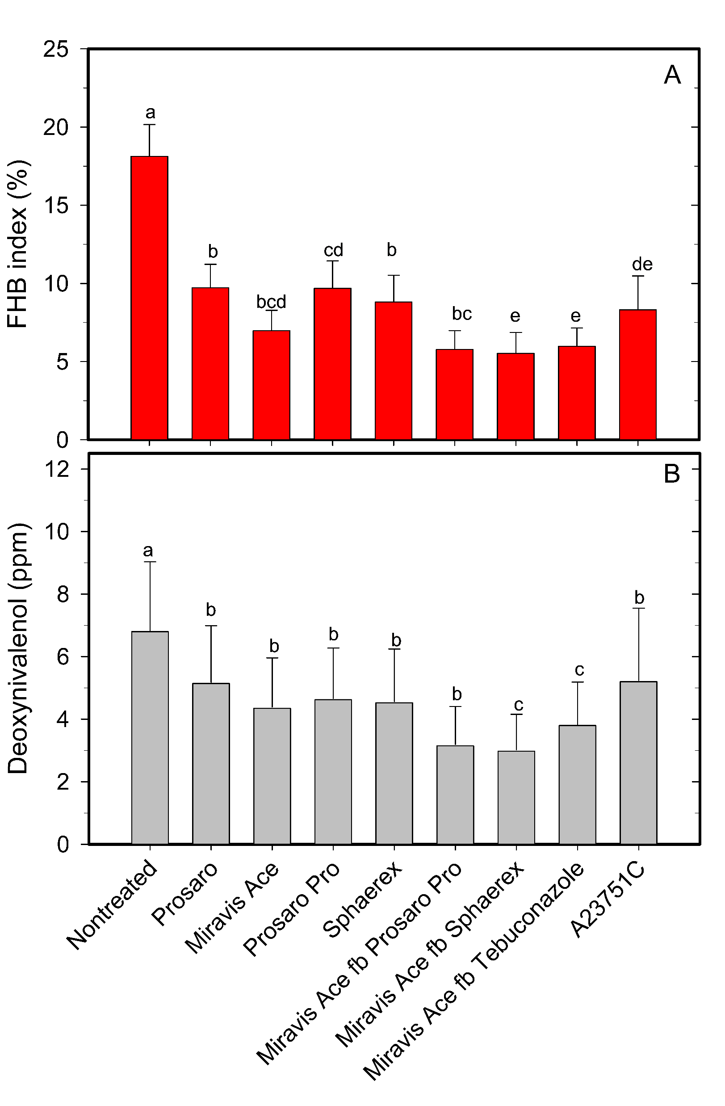
2025 FHB and DON Response to Fungicide Treatments (UFT Trials)
UFT data for the 2025 growing season.
Bars show mean (± SE) Fusarium head blight (FHB) index (A) and deoxynivalenol (DON) levels (B) for single anthesis fungicide applications and sequential applications where Miravis Ace at anthesis was followed by Prosaro Pro, Sphaerex, or Tebuconazole 4–6 days later
Different letters indicate significant differences among treatments.

Slide 5
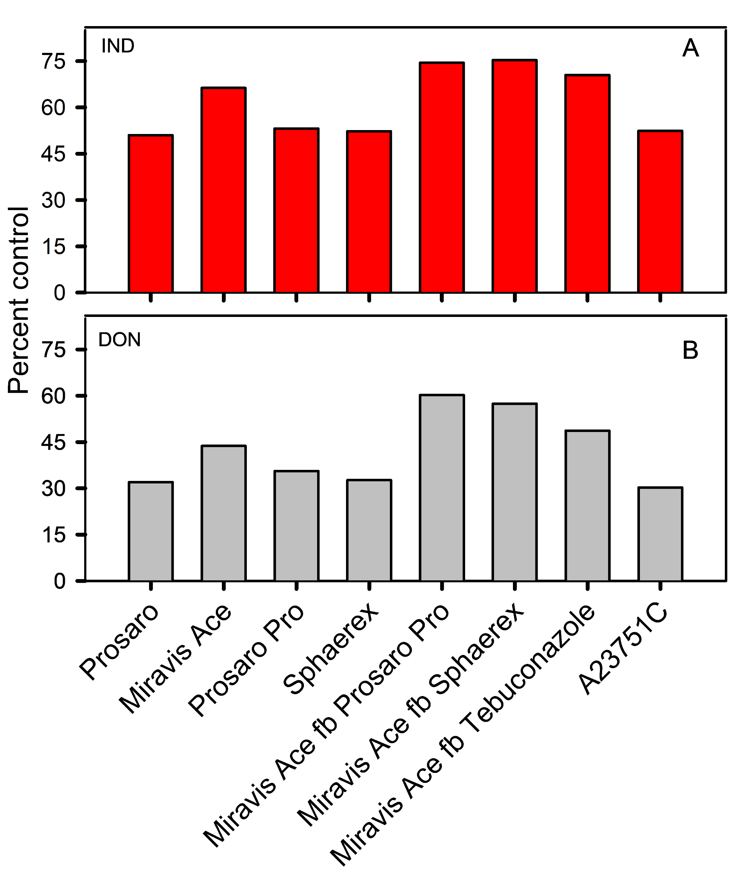
Fungicide Efficacy Against FHB and DON (2022–2025 UFT Trials)
Percent reduction relative to the nontreated control for Fusarium head blight (FHB) index (A) and deoxynivalenol (DON) levels (B), based on combined data from UFT trials conducted during the 2022–2025 growing seasons.
Fungicide programs included single applications at anthesis and sequential applications in which Miravis Ace at anthesis was followed by Prosaro Pro, Sphaerex, or Tebuconazole 4–6 days later.
Treatment A23751C was evaluated only during the 2024 and 2025 seasons.
Notes:
Fungicide Efficacy Against FHB and DON (2022–2025 UFT Trials)

Slide 6
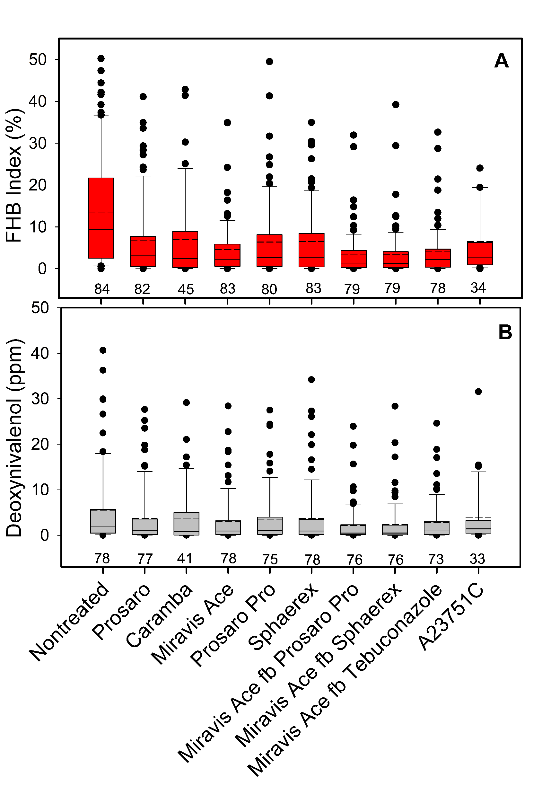
Distribution of FHB Severity and DON for Single and Sequential Fungicide Applications (2022–2025)
Combined data from multi‑environment UFT trials conducted during the 2022–2025 growing seasons.
Boxplots show the distribution of Fusarium head blight (FHB) index (A) and deoxynivalenol (DON) levels (B) for single anthesis and sequential fungicide applications where Miravis Ace at anthesis was followed by Prosaro Pro, Sphaerex, or Tebuconazole 4–6 days later
Numbers on the x‑axis indicate the number of trials contributing to each distribution.

Slide 7
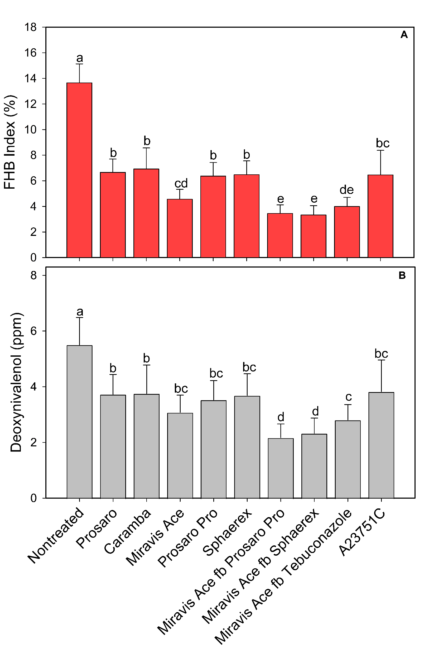
Mean FHB Severity and DON From UFT Fungicide Trials (2022–2025)
Combined data from UFT locations during 2022–2025 growing seasons.
Bars show mean (± SE) Fusarium head blight (FHB) index (A) and deoxynivalenol (DON) levels (B) for single anthesis and sequential where Miravis Ace at anthesis was followed by Prosaro Pro, Sphaerex, or Tebuconazole 4–6 days later
Different letters indicate significant differences among treatments.
The A23751C treatment includes data only from the 2024 and 2025 seasons.

Slide 8
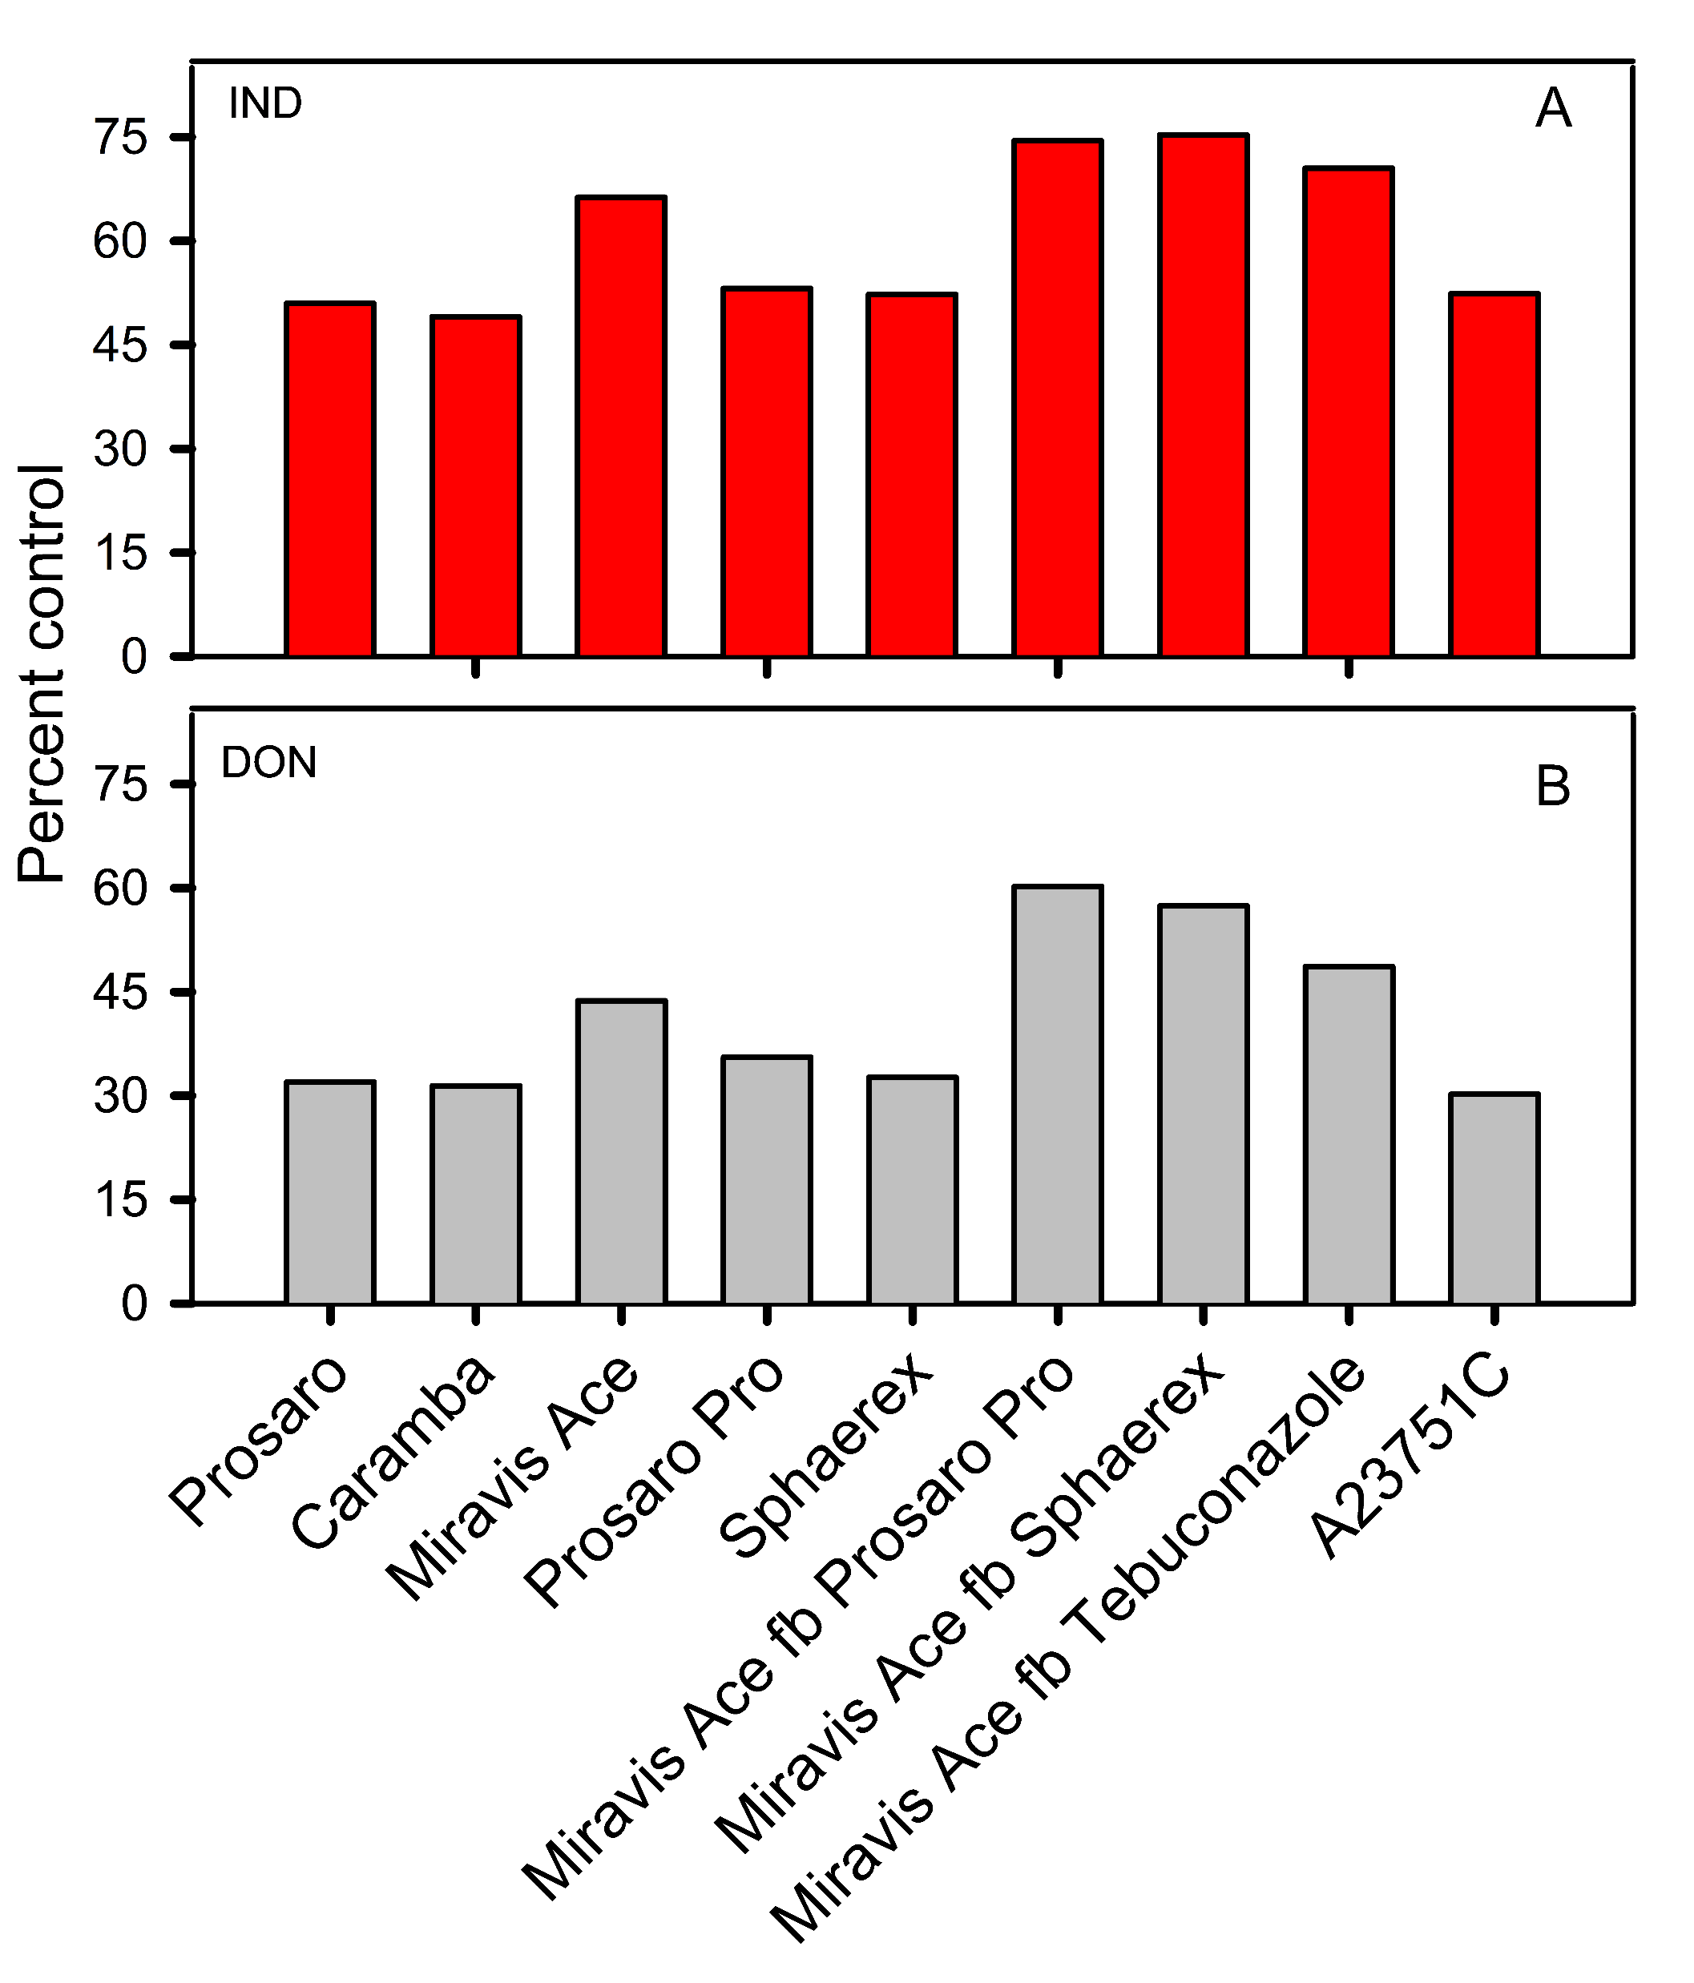
Fungicide Efficacy (%) for FHB Severity and DON From UFT Trials (2022–2025)
Percent control relative to the control for Fusarium head blight (FHB) index (A) and deoxynivalenol (DON) levels (B), based on combined data from UFT trials conducted during the 2022–2025 growing seasons.
Fungicide programs included single applications at anthesis and sequential applications in which Miravis Ace at anthesis was followed by Prosaro Pro, Sphaerex, or Tebuconazole 4–6 days later.
Treatment A23751C was evaluated only during the 2024 and 2025 seasons.

Slide 9
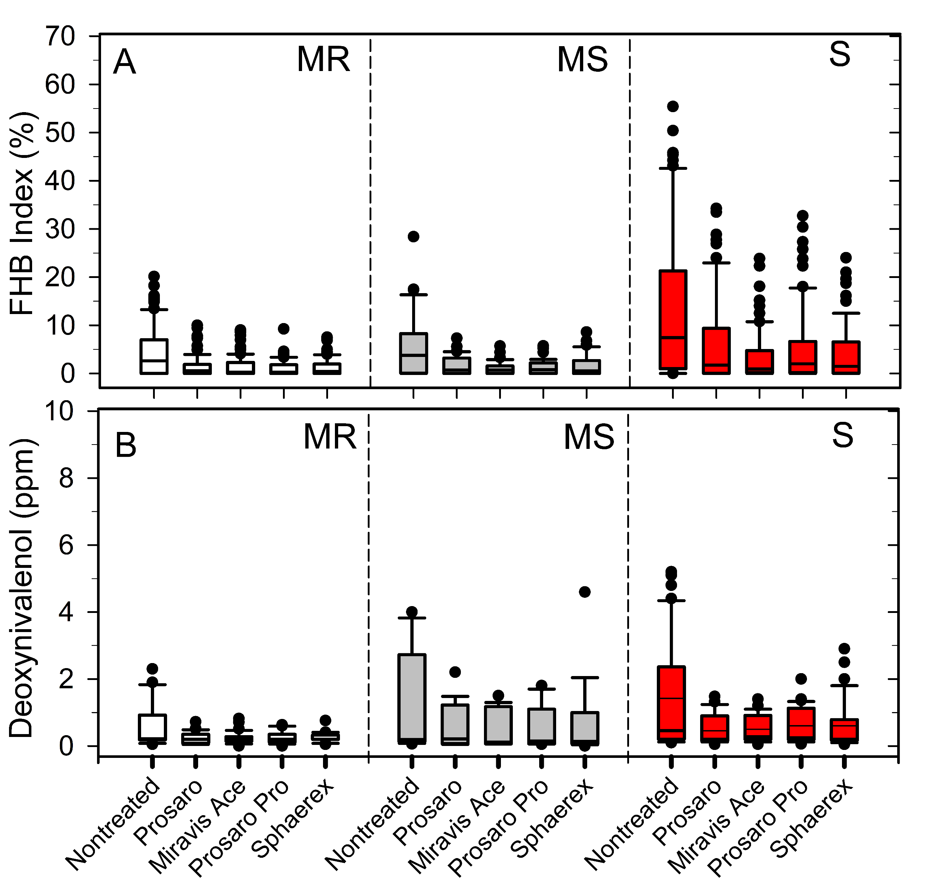
2025 Distribution of FHB and DON Across Fungicide Treatments and Host Classes
Distribution of least squares means for Fusarium head blight (FHB) index (A) and deoxynivalenol (DON) levels (B) from multi‑location trials conducted during the 2025 growing season.
Boxplots summarize variation across fungicide treatments within three host‑susceptibility classes.
MR = Moderately Resistant; MS = Moderately Susceptible; S = Susceptible

Slide 10
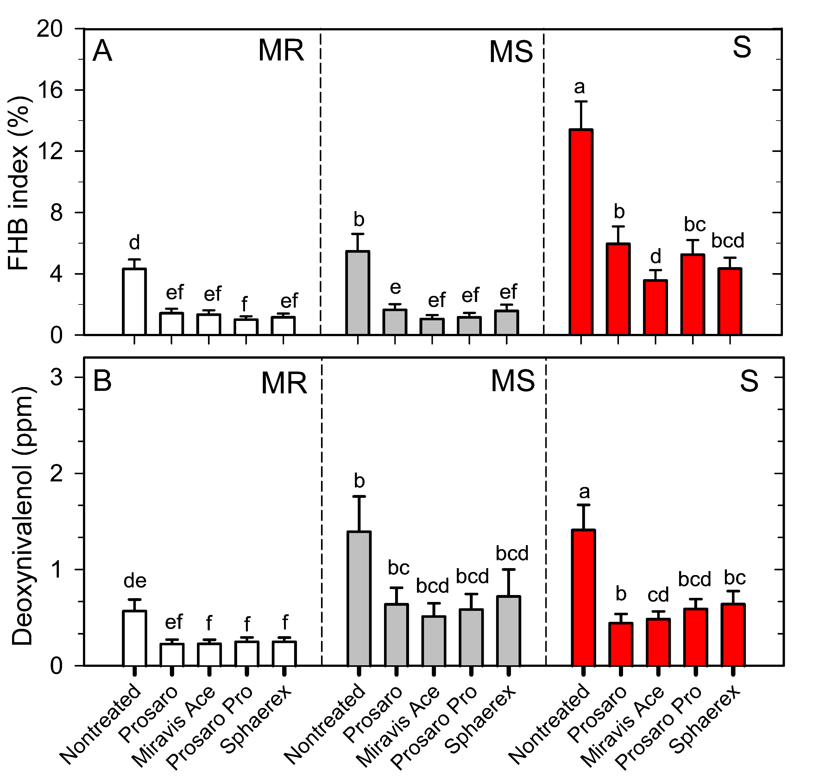
2025 Mean FHB and DON Across Fungicide Programs and Host Classes
Mean (± SE) Fusarium head blight (FHB) index (A) and deoxynivalenol (DON) levels (B) across fungicide treatments within three host‑susceptibility classes, based on multi‑location trials from 2025 growing season.
Different letters indicate significant differences among treatments across host class
MR = Moderately Resistant; MS = Moderately Susceptible; S = Susceptible

Slide 11
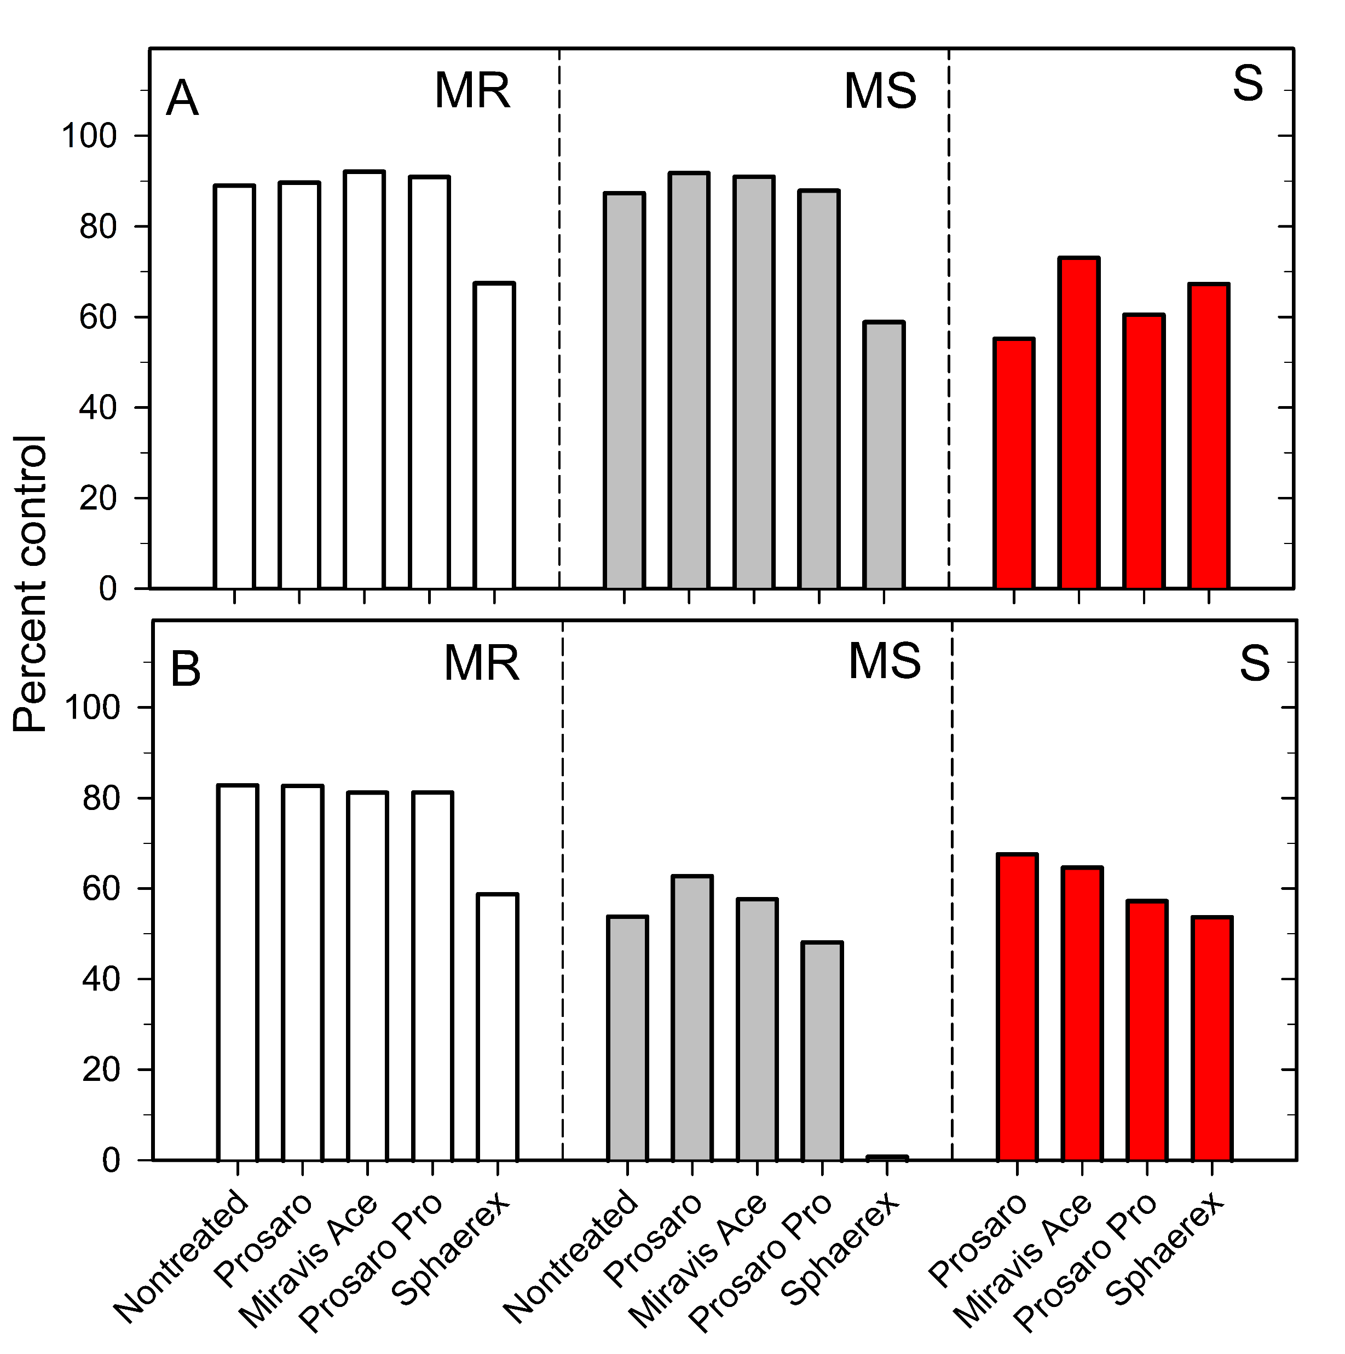
Percent Control of FHB and DON in 2025 Integrated Management Trials
Percent control relative to a susceptible check for Fusarium head blight (FHB) index (A) and deoxynivalenol (DON) levels (B), based on combined data from Integrated Management (IM) trials conducted during the 2025 growing season.
Programs included wheat varieties of differing susceptibility classes and fungicide applications applied at anthesis.
MR = Moderately Resistant; MS = Moderately Susceptible; S = Susceptible

Slide 12
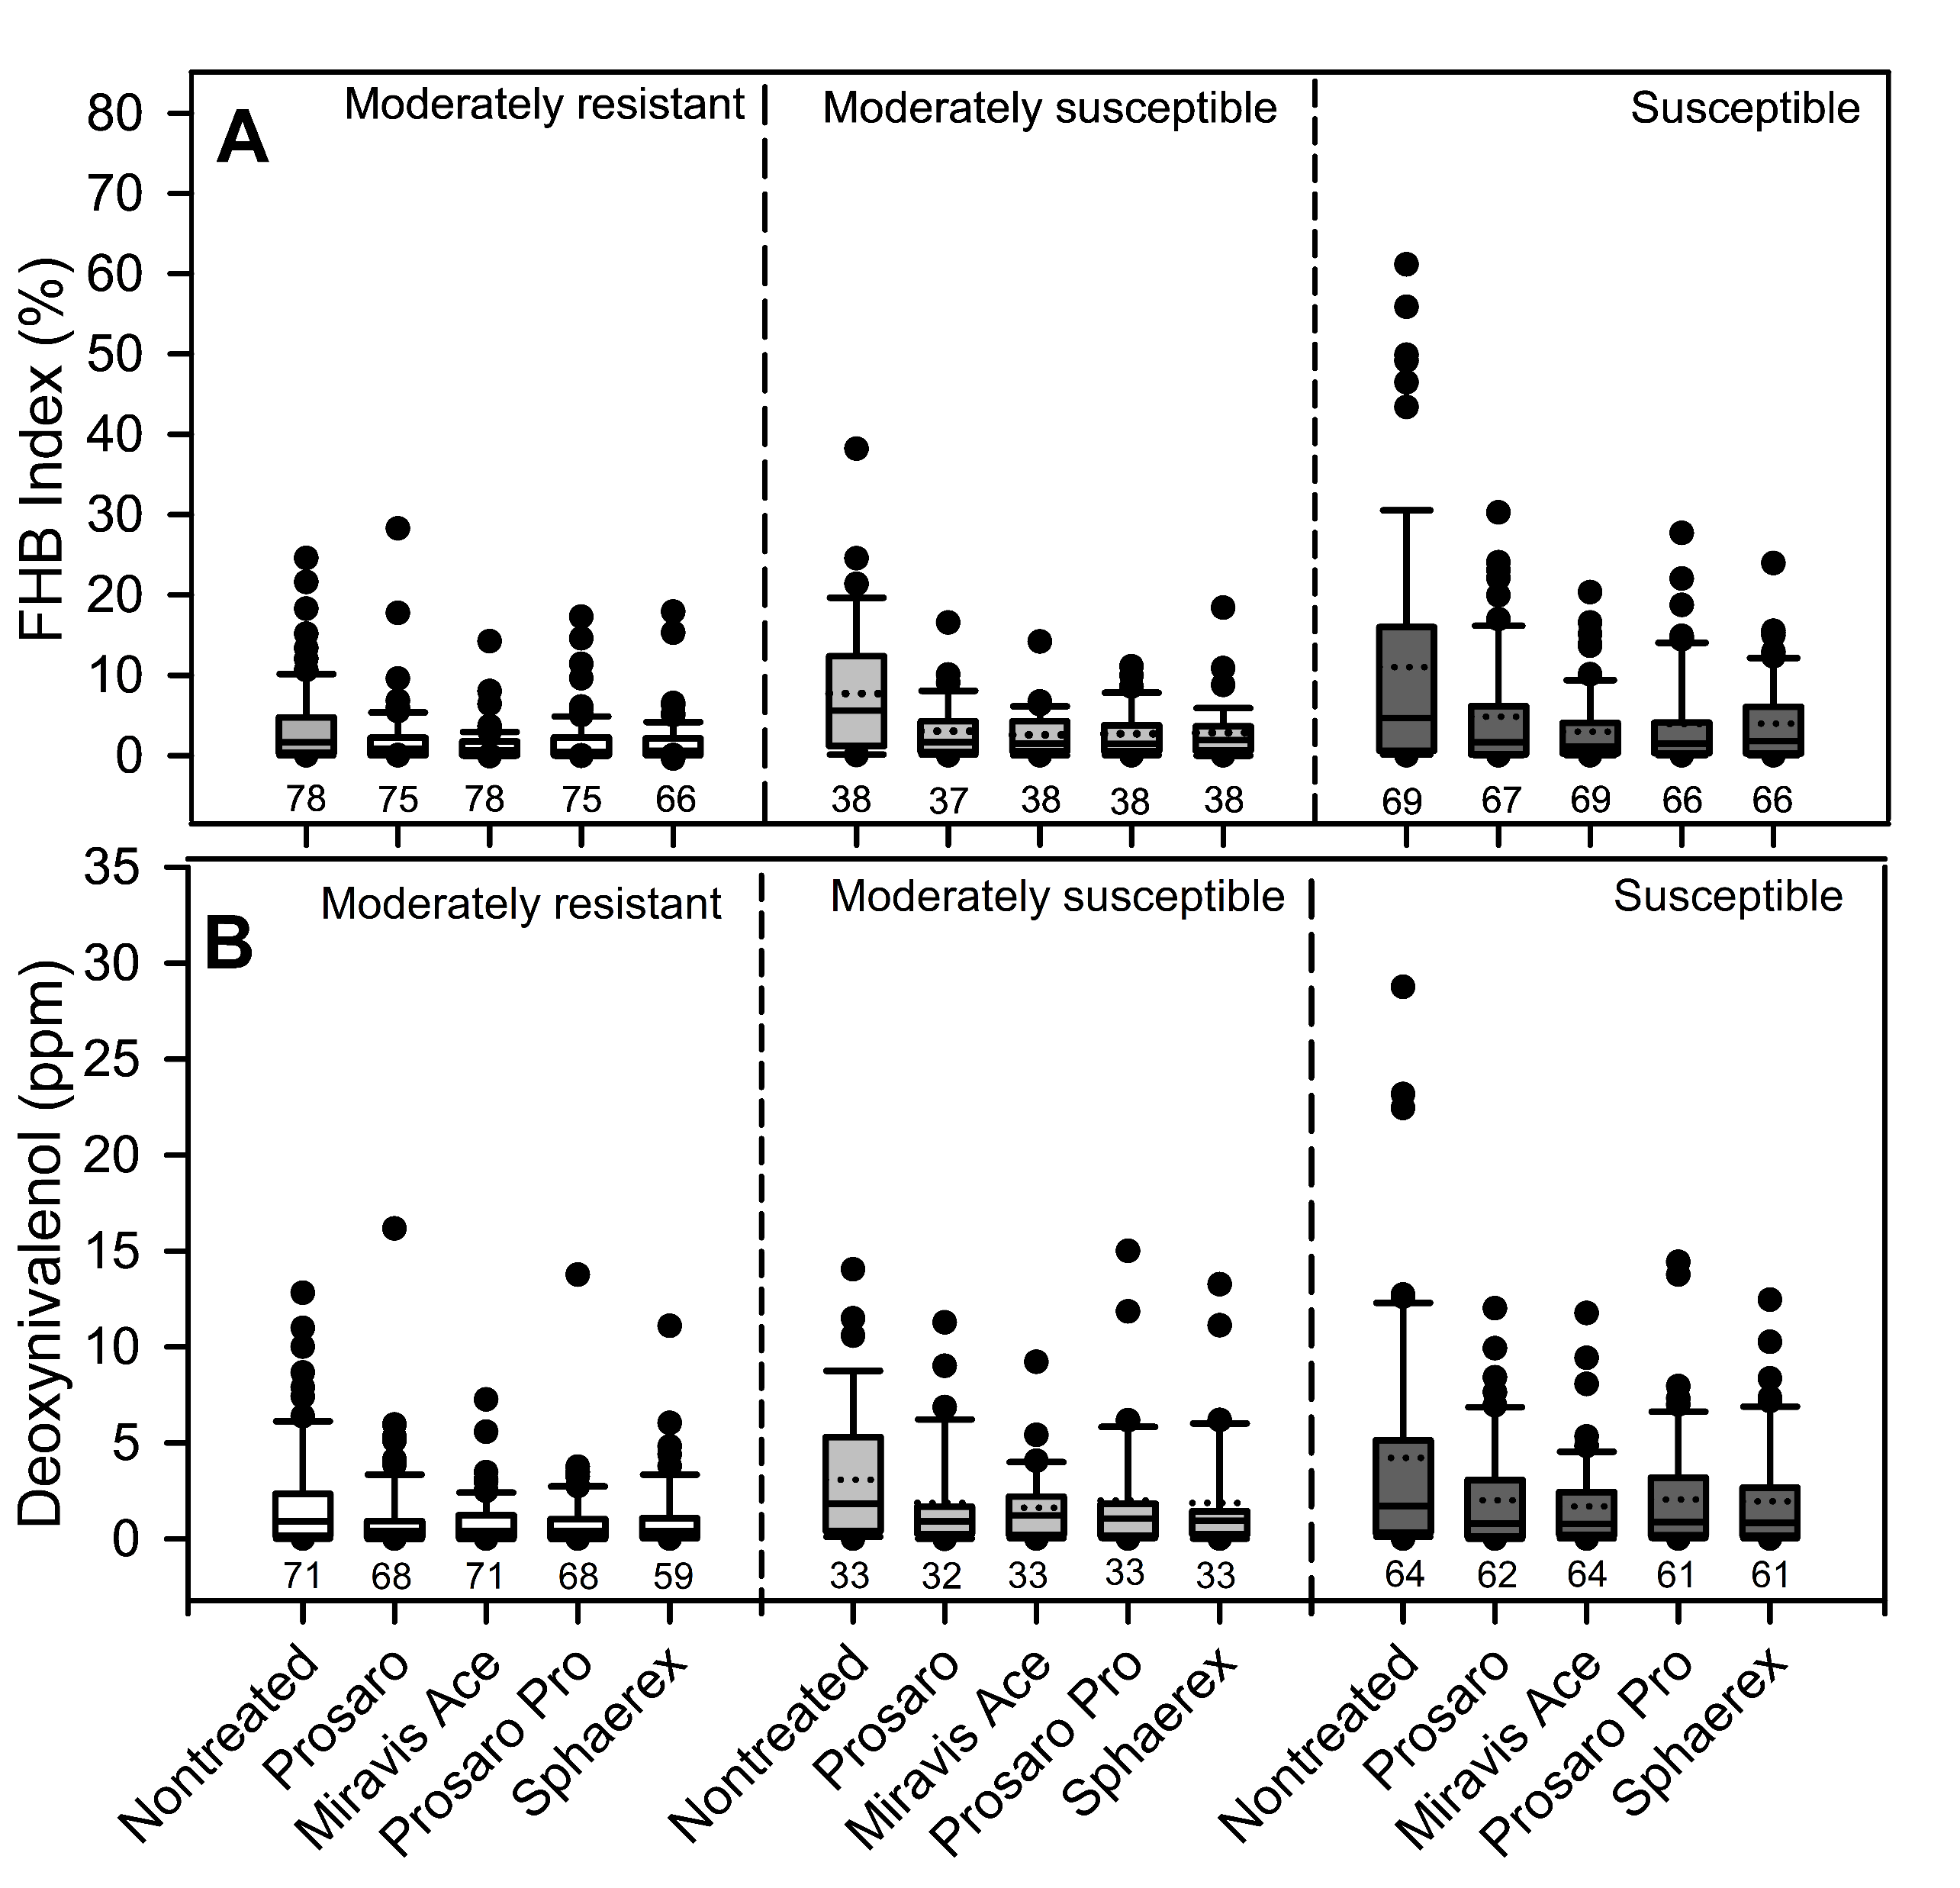
FHB and DON Least Squares Mean Distributions (2022–2025)
Distribution of least squares means for Fusarium head blight (FHB) index (A) and deoxynivalenol (DON) levels (B) from multi‑location trials conducted during the 2022–2025 growing seasons.
Boxplots summarize variation across fungicide treatments within three host‑susceptibility classes.
Numbers below each box indicate the number of contributing trials

Slide 13
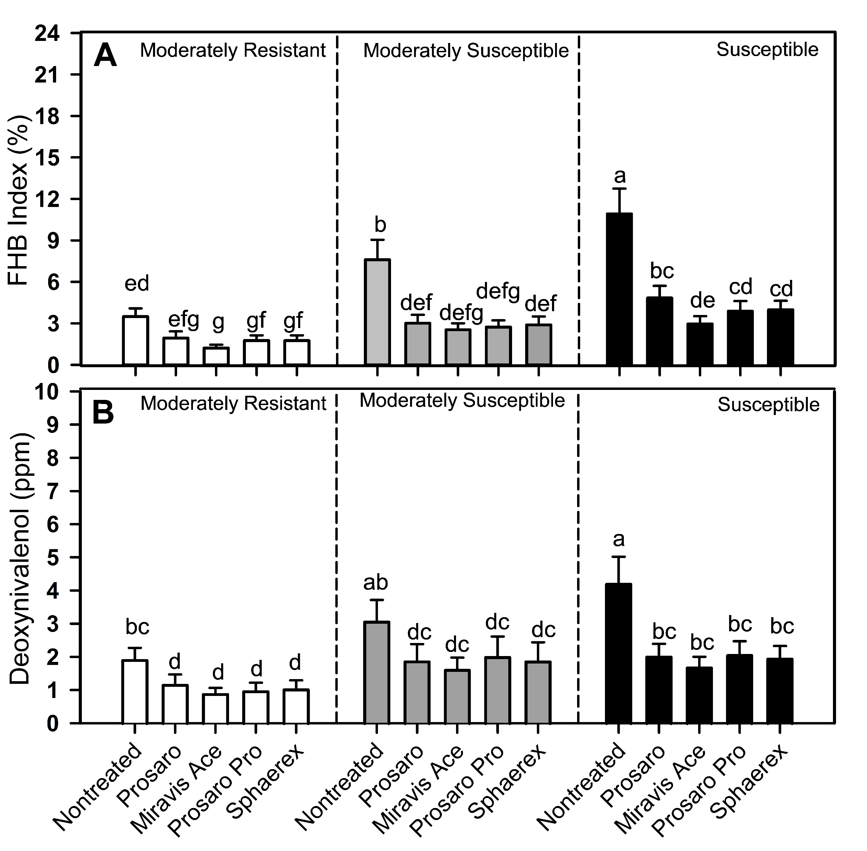
FHB and DON Means by Fungicide Treatment and Host Susceptibility (2022-2025)
Mean (± SE) Fusarium head blight (FHB) index (A) and deoxynivalenol (DON) levels (B) across fungicide treatments within three host‑susceptibility classes, based on multi‑location trials from 2022–2025.
Different letters indicate significant differences among treatments across host class

Slide 14
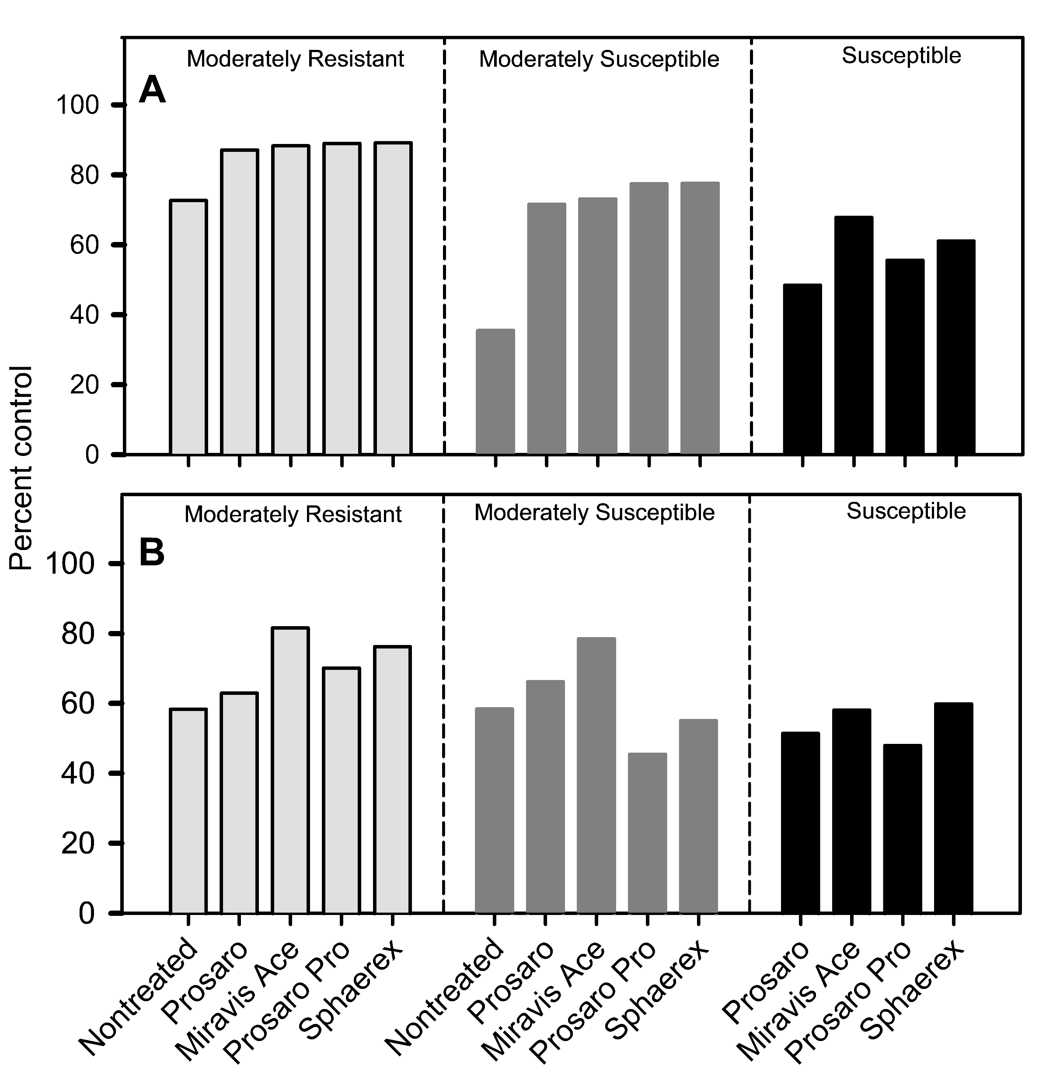
Percent Control of FHB and DON Across Host Classes and Fungicide Programs (2022–2025)
Percent control relative to a susceptible check for Fusarium head blight (FHB) index (A) and deoxynivalenol (DON) levels (B), based on combined data from Integrated Management (IM) trials conducted during the 2022–2025 growing seasons.
Programs included wheat varieties of differing susceptibility classes and fungicide applications applied at anthesis.

